Slide 1


Optimum packaging & delivery methodology
Team From :
Systems Ltd.

Slide 2






The Team
Chaitra Date
Pooja Ganar
Nidhi Morolia
Priyanka Sutar
Abhishek Sharma
Sameer Pokarna (Mentor)
Specialist Product Owner
UX Designer
Specialist QA Engineer
Tech Lead Software Engineer
Software Engineer
Software Architect

Slide 3
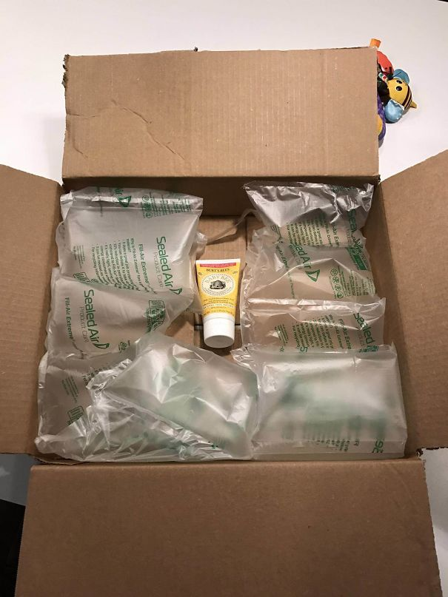
Wasteful packaging!
E-commerce is increasing worldwide driving large amounts of plastic waste that gets generated due to excessive packaging of products.
All the plastic waste that gets generated ends up at landfill sites, leading to a burden on the earth and damaging the environment.
There’s an increased need to find new solutions for the way goods are delivered to the end consumer.
We need to move towards sustainable solutions for packaging and implement alternative delivery practices.

Slide 4
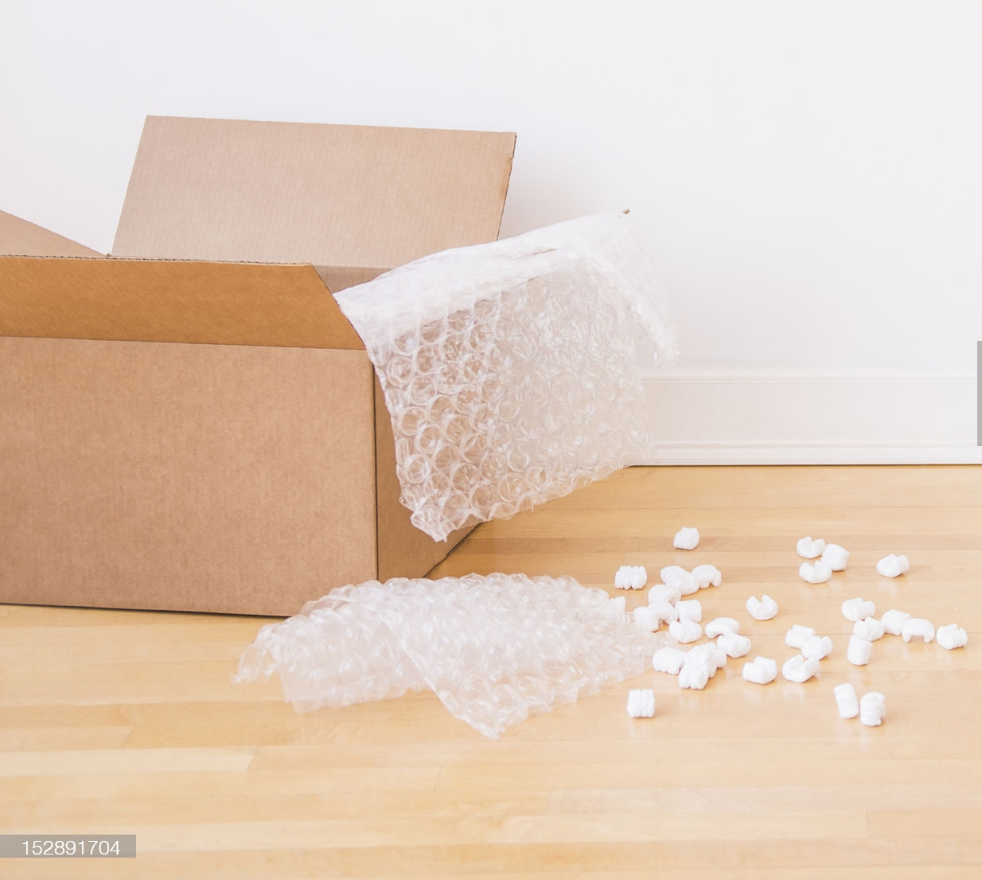
The UGLY side of beauty
Do we really need the excessive packaging? Can we not do without it? Of course, we can.
In recent times there has been a shift from in-store trial dependent purchases of skincare and beauty products to buying them online using digital channels. Packaging and shipping of these skincare and beauty products could be tricky and tactical.
Current packaging methods include use of oversized cardboard boxes and multiple layers of plastic packaging.
Huge amount of trash including torn carboard boxes and plastic packaging material gets generated with every online delivery.
Mostly products come with their company branded packaging enough to survive spillage and ensure that the product reaches the consumer in desired condition. This arises the need to think if we really need the excessive packaging? Can we not do without it? Of course, we can.

Slide 5
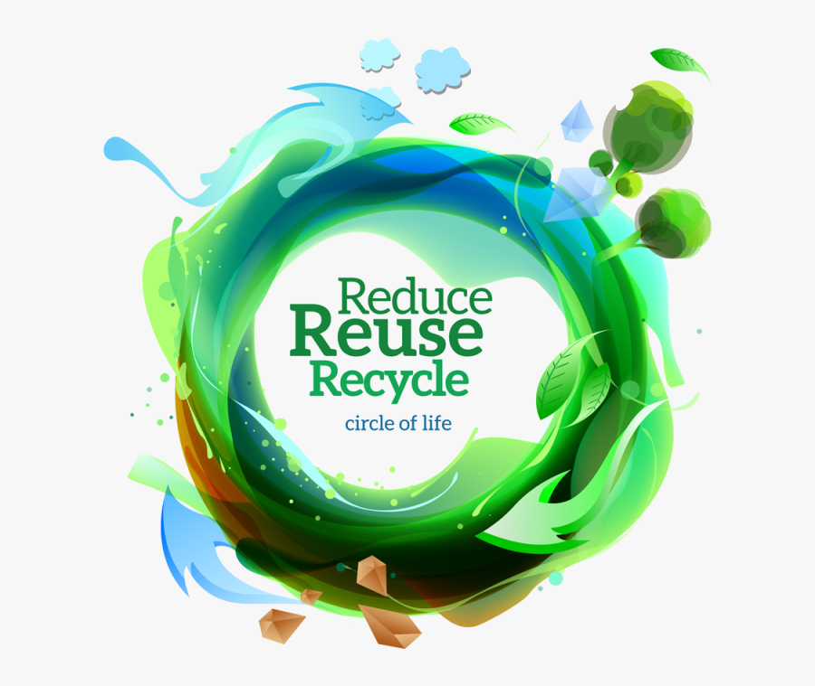
Proposed Solution
A small step towards sustainable packaging methodology
Introduce sustainable delivery option in the checkout process.
Customers will either receive ordered products in without extra packaging, biodegradable packaging or will have to return the packaging to the vendor.
Parameters considered for determining optimum method of packaging and delivery include:
Size, weight & volume of items
Fragility
Spillage probability
Privacy (Personal items)
Source & delivery locations
Delivery practice opted will vary based on these parameters and could range from biodegradable packaging, to returning the packaging or using re-usable boxes for carrying multiple orders together.
Customers will be rewarded with redeemable points which they could reuse for subsequent purchases.
Following a few simple practices into your processes and delivery options will improve your packaging footprint and also bring huge savings.
P.S.: We will be referring to the category of makeup & skincare products to explain our sustainability idea.

Slide 6
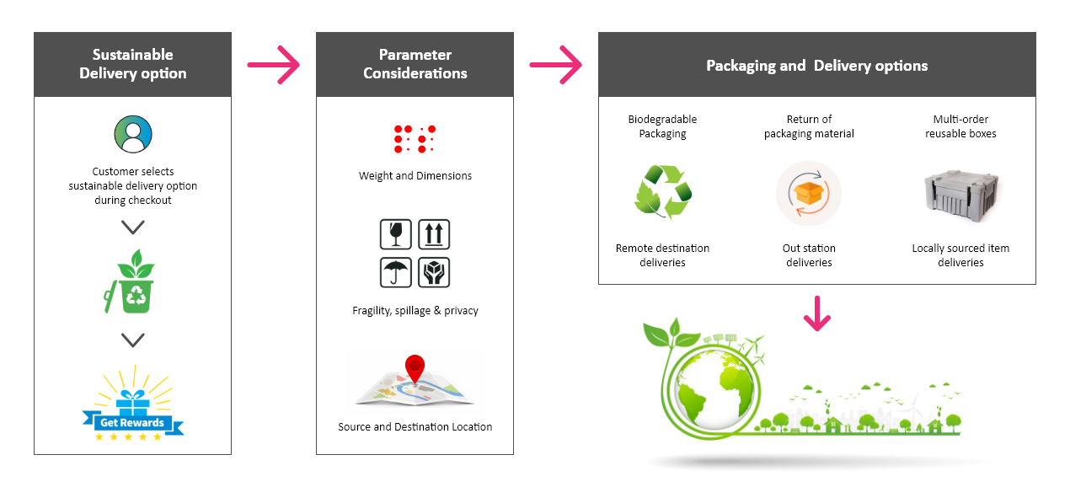
Sustainable Packaging

Slide 7

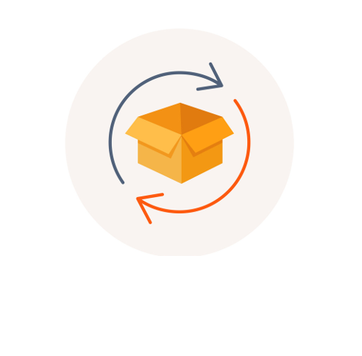
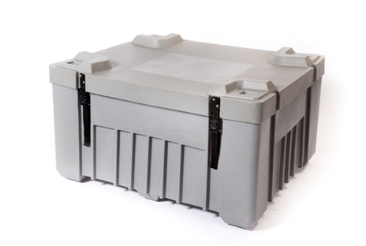
Sustainable Delivery Mechanism
Biodegradable packaging material
In case of remote deliveries where the recycling arrangements can be difficult, companies can opt for slightly expensive but biodegradable packaging options.
Return Packaging material back to source
In case the delivery requires outstation, courier service which cannot be achieved without extra packaging for safety purposes, or in cases where the product is fragile and there are changes or spillage; the customer will be directed to hand over the packaging back to the delivery person. The e-commerce company will make arrangements to take back the plastic material and ensure that it is recycled.
Use of re-usable boxes for carrying multiple orders together
In case of local deliveries, multiple orders can be carried by the delivery person in re-usable bags or boxes; and hand over the items to the customer.

Slide 8



Win-win case for the companies, customers and most importantly the environment
Benefits to Customer
Contribution towards reducing carbon footprint
Savings on subsequent purchases
Business Benefits
Building brand value
Acquire more customers and boost loyalty
Lower shipping costs by reducing packaging materials and shipping smaller packages
Improved Delivery Efficiency
Transforming into Green Commerce
Tax credits and incentives

Slide 9
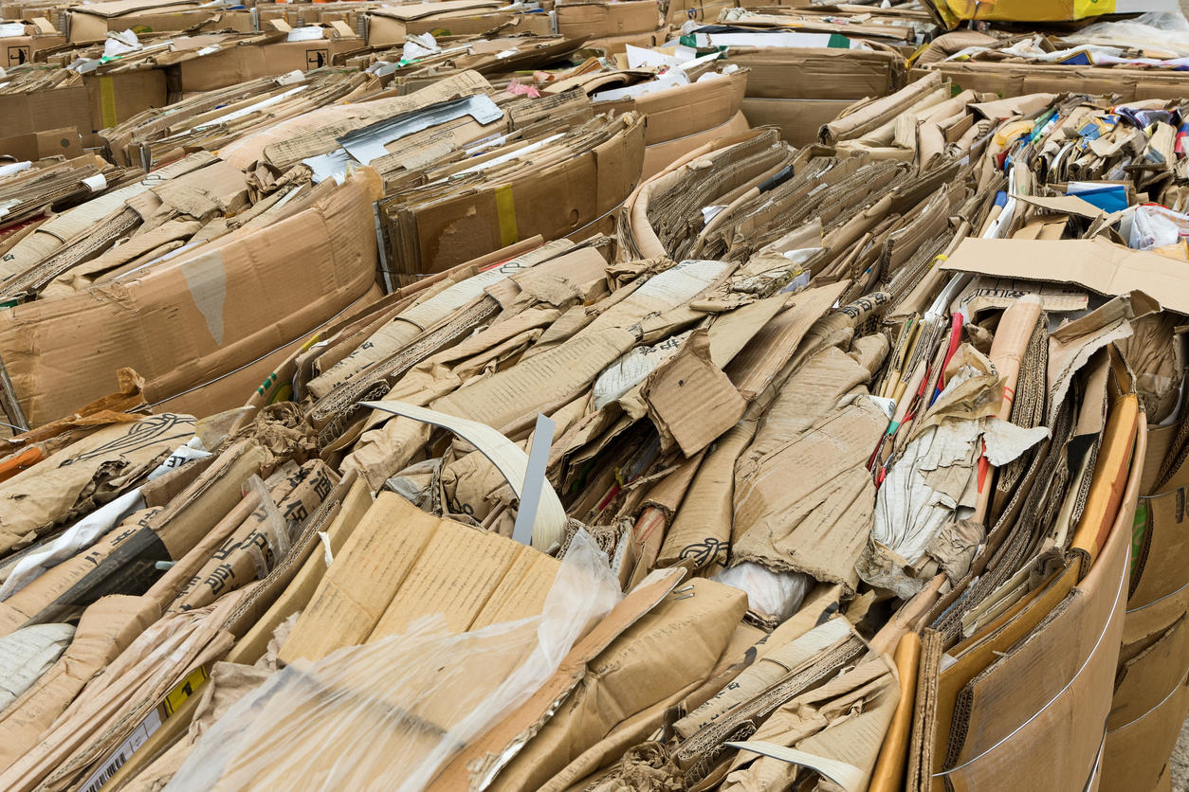
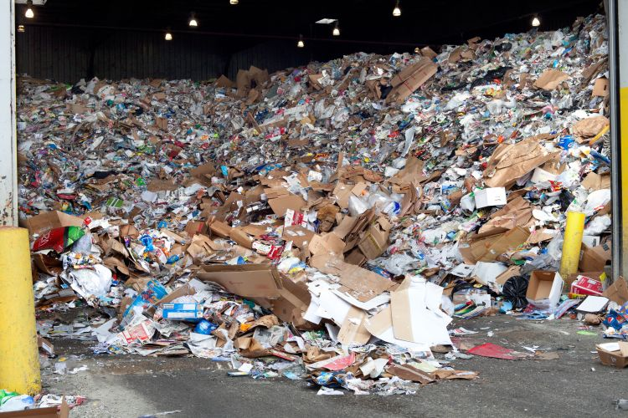
What are the directives and rules?
E-commerce giants need to fulfil their extended producer responsibility under the Plastic Waste Management Rules, 2016.
They need to establish a system for collecting back the plastic waste generated due to the packaging of their products as per the Central Pollution Control Board directives.
As per provisions 9(2) of the Plastic Waste Management (PWM) Rules, 2016, primary responsibility for collection of used multi-layered plastic sachet or pouches or packaging is of Producers, Importers and Brand Owners who introduce the products in the market.
Online retailers that are involved in packaging and selling of other companies' products and thus introducing plastic packaging in the market need to fulfil their extended producer responsibility under PWM Rules.
But the truth is that due to a lack of monitoring and implementation, these e-commerce companies continue to use excessive amounts of plastic in wrapping and packaging their sold items.

Slide 10

What does research say?
A survey by CGS of 1,000 U.S. consumers found that almost 70% of respondents considered sustainability as at least “somewhat important” and almost half (47%) said that would pay 25% more for sustainable products.
A research by Nielsen found that 48% of consumers are willing to change their consumption habits to lower their impact on the environment. And that’s not just lip service.

Slide 11
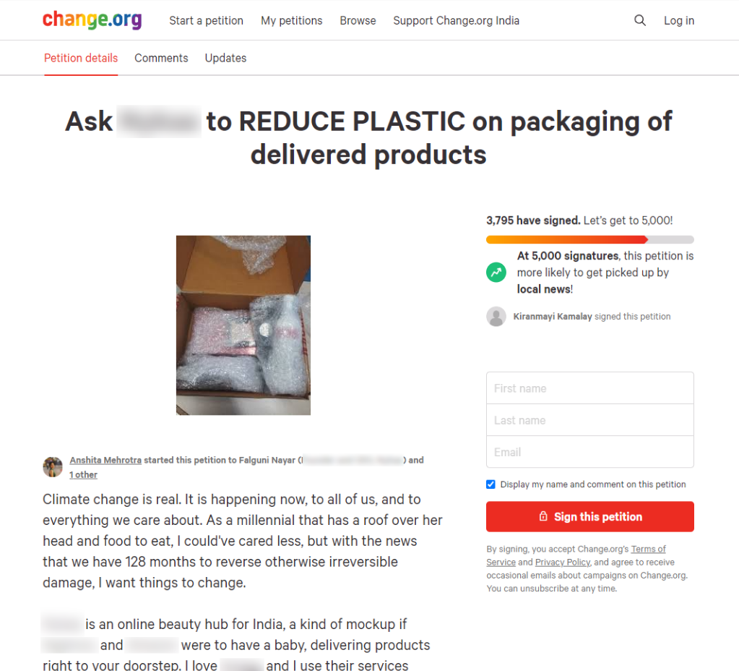
Movement to reduce plastic on packaging of delivered products
Here’s a petition you could sign to help REDUCE PLASTIC on packaging of delivered products
https://www.change.org/p/falguni-nayar-reduce-plastic-on-packaging-of-delivered-products-from-nykaa/c

Slide 12
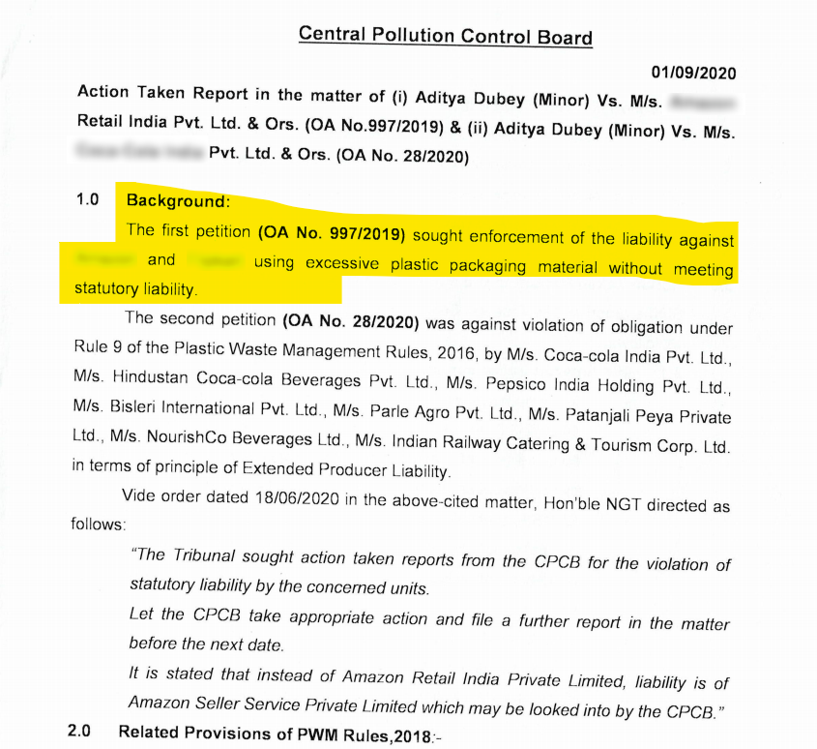
Plea filed by a 16-year-old boy who has approached the NGT to stop e-commerce giants from excessive plastic use in their packaging
Aditya Dubey’s plea prompts National Green Tribunal to seek report from the Central Pollution Control Board
A 16-year-old boy named Aditya Dubey Aditya Dubey, through his legal guardian, has pleaded the National Green Tribunal (NGT) to direct Amazon and Flipkart to stop excessive use of plastics in packaging goods delivered by the firms.
Plastic packaging constitutes 43 per cent of the total plastic waste generated in India and it is imperative that a direction be issued to the respondents that they should stop using plastic packaging materials and shift to environment friendly packaging options.
Report by Central Pollution control board

Slide 13






Solution Roadmap
Sustainable packaging is becoming a higher priority for both brands and consumers – it is clearly more than a buzzword.
Implementing optimum packaging and delivery mechanisms in your brand’s operations is no longer an option - it’s a necessity.
Innovative new eco-friendly alternatives to traditional packaging
Product Containers disposal and reuse (especially for subscription and home –delivery based beauty brands)
Distribution through collection centers instead of door-to-door deliveries of products
Generate reports to indicate customer adoption towards sustainable packaging options
Data analysis of savings created by adopting optimum packaging and delivery mechanisms
Sending back packaging material either in same cycle or on next order using drone deliveries

Slide 14
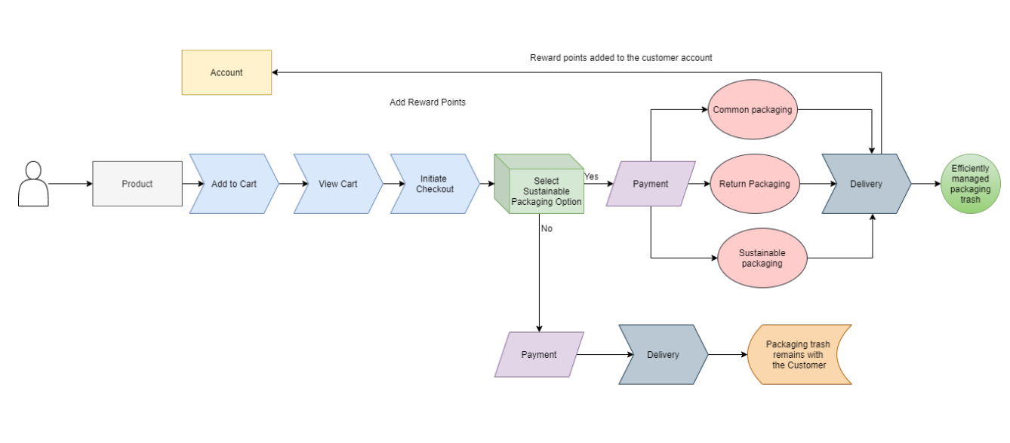
System Flow Diagram

Slide 15
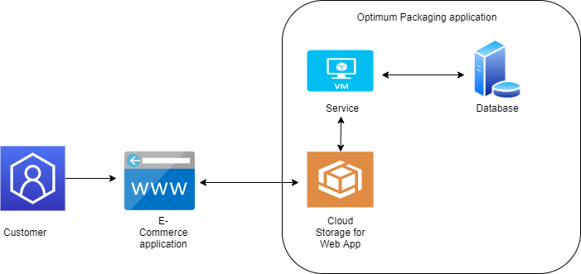
Architecture Diagram

Slide 16
Thank You!
Team From :
Systems Ltd.

